Slide 1
Description in adverts

Slide 2
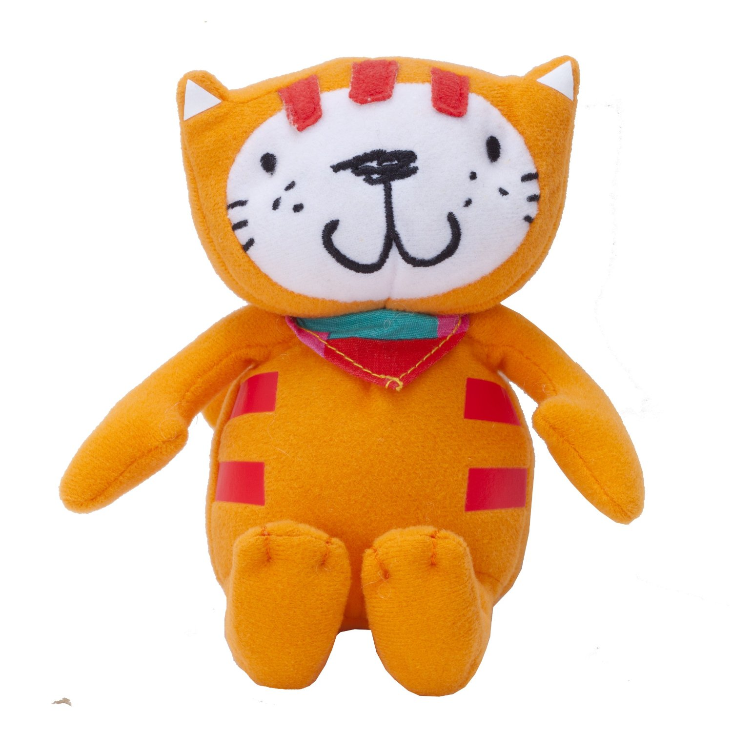
Poppy Cat
Wonderfully soft and cuddly
Embroidered features
15cm tall
Great pocket sized travel friend

Slide 3
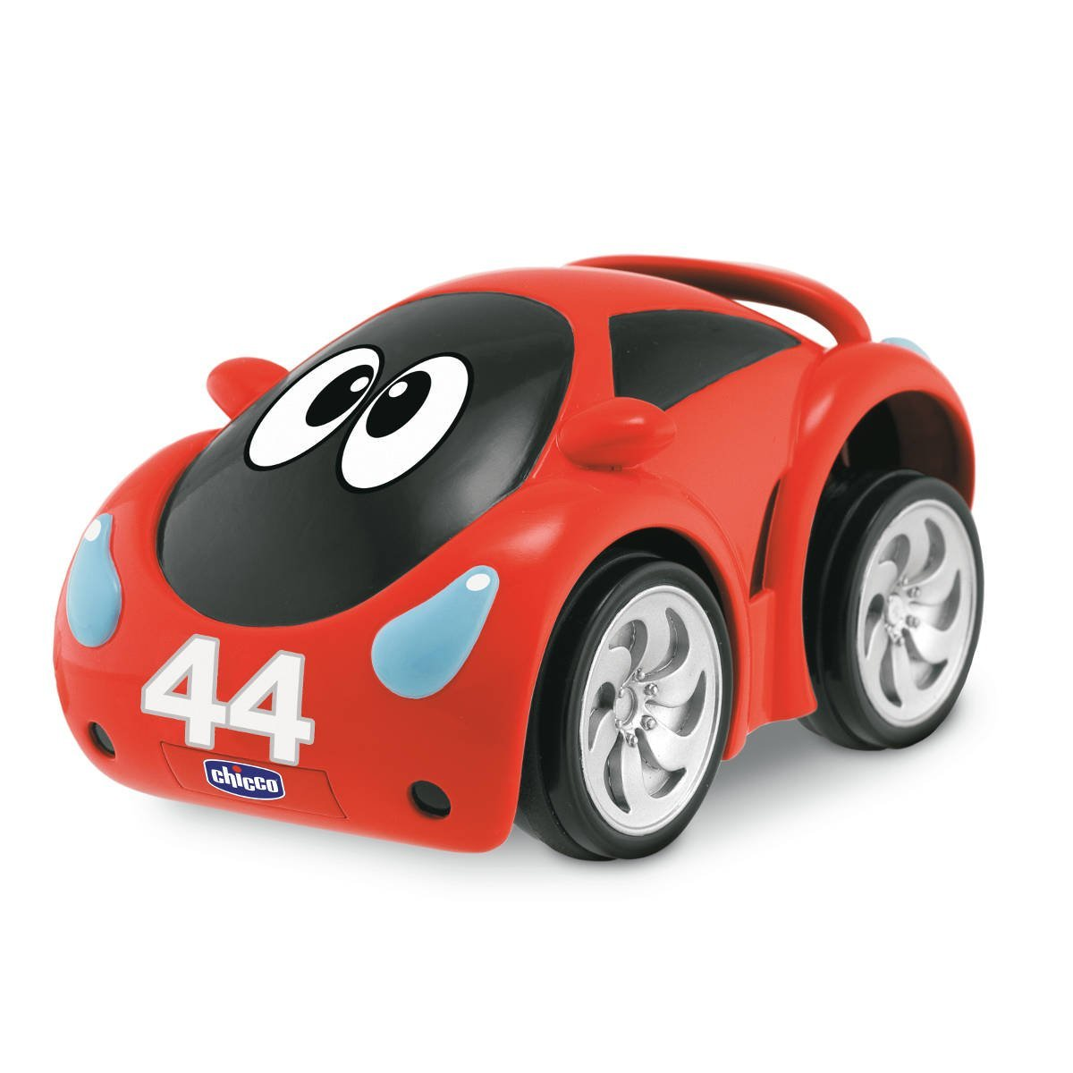
Turbo pull and go car
Chunky miniature sports car
Realistic race track sounds
Revs up when pressed down
Colourful and interactive
For ages 1-5

Slide 4
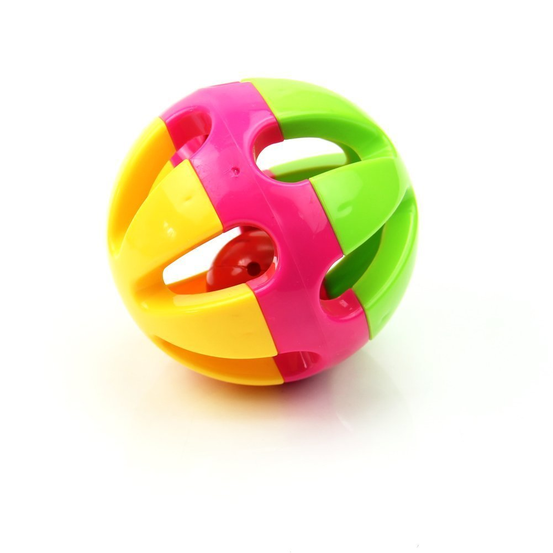
Rattle ball
A pretty silver bell inside a ball
Rattles when shaken
Bright, colourful plastic
Yellow, hot pink and green
8cm across
Suitable for 3 months +

Slide 5
Quadcopter drone
High quality
Ultra small in size
Very light and delicate
Excellent control
Can fly for up to 8 minutes
LED light for night flying
Flies up and down, hovers and flips

